Slide 1
OOD
Class Diagrams in Greater Detail
Morag Robertson

Slide 2
OOD
Class Diagrams
The class diagram shows the building blocks of any object-orientated system. Class diagrams depict a static view of the model, or part of the model, describing what attributes and behaviour it has rather than detailing the methods for achieving operations. Class diagrams are most useful in illustrating relationships between classes and interfaces
Morag Robertson

Slide 3
OOD
Class diagrams are widely used to describe the types of objects in a system and their relationships. Class diagrams model class structure and contents using design elements such as classes, packages and objects. Class diagrams describe three different perspectives when designing a system, conceptual, specification, and implementation. These perspectives become evident as the diagram is created and help solidify the design.
Morag Robertson

Slide 4
OOD
Class Notation
Classes are represented by rectangles which show the name of the class and optionally the name of the operations and attributes. Compartments are used to divide the class name, attributes and operations.
Morag Robertson

Slide 5
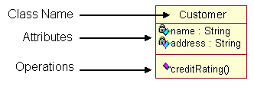
OOD
Classes are composed of three things: a name, attributes, and operations. Below is an example of a class.
Morag Robertson

Slide 6
OOD
Class diagrams also display relationships such as containment, inheritance, associations and others. Below is an example of an associative relationship
Morag Robertson

Slide 7
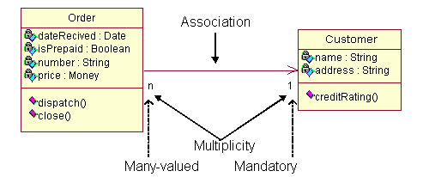
OOD
Morag Robertson

Slide 8
OOD
The association relationship is the most common relationship in a class diagram. The association shows the relationship between instances of classes. For example, the class Order is associated with the class Customer. The multiplicity of the association denotes the number of objects that can participate in then relationship.For example, an Order object can be associated to only one customer, but a customer can be associated to many orders.
Morag Robertson

Slide 9
OOD
Another common relationship in class diagrams is a generalization. A generalization is used when two classes are similar, but have some differences. Look at the generalization below:
Morag Robertson

Slide 10
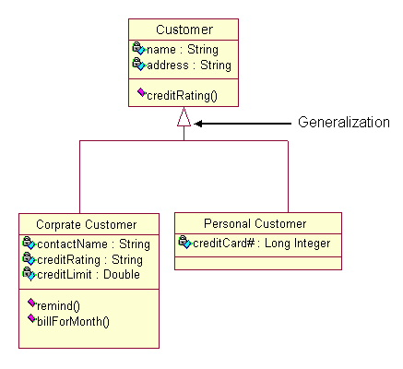
OOD
Morag Robertson

Slide 11
OOD
In this example the classes Corporate Customer and Personal Customer have some similarities such as name and address, but each class has some of its own attributes and operations. The class Customer is a general form of both the Corporate Customer and Personal Customer classes. This allows the designers to just use the Customer class for modules and do not require in-depth representation of each type of customer.
Morag Robertson

Slide 12
OOD
Before drawing a class diagram consider the three different perspectives of the system the diagram will present; conceptual, specification, and implementation. Try not to focus on one perspective and try see how they all work together.
When designing classes consider what attributes and operations it will have. Then try to determine how instances of the classes will interact with each other. These are the very first steps of many in developing a class diagram. However, using just these basic techniques one can develop a complete view of the software system.
Morag Robertson

Slide 13
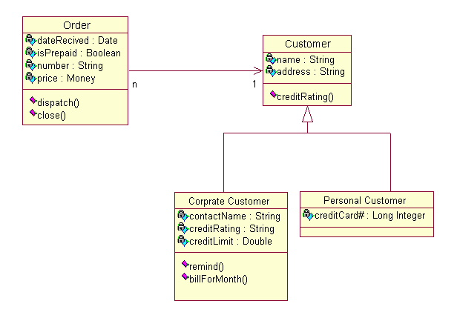
OOD
Morag Robertson

Slide 14
OOD
Part of these diagrams are generalizations, aggregations, and associations and they are all valuable in reflecting inheritance, composition or usage, and connections respectively.
Morag Robertson

Slide 15
OOD
The diagram below illustrates aggregation relationships between classes. The lighter aggregation indicates that the class "Account" uses AddressBook, but does not necessarily contain an instance of it. The strong, composite aggregations by the other connectors indicate ownership or containment of the source classes by the target classes, for example Contact and ContactGroup values will be contained in AddressBook.
Morag Robertson

Slide 16
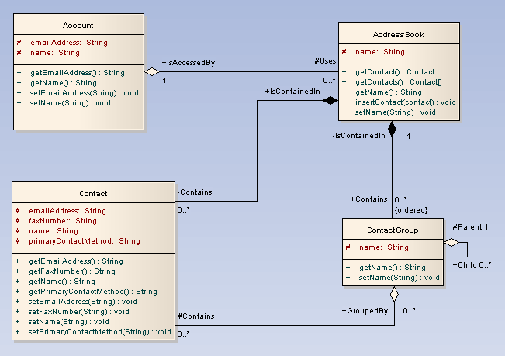
OOD
Morag Robertson

Slide 17
OOD
A class is an element that defines the attributes and behaviours that an object is able to generate. The behaviour is described by the possible messages the class is able to understand, along with operations that are appropriate for each message. Classes may also have definitions of constraints, tagged values and stereotypes.
Morag Robertson

Slide 18
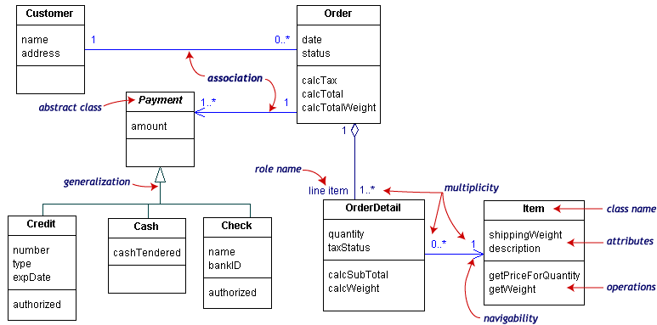
OOD catalogue example
Morag Robertson

